Slide 1
More About Auto-encoder
Hung-yi Lee 李宏毅

Slide 2


Auto-encoder
As close as possible
NN
Encoder
NN
Decoder
vector
Embedding, Latent Representation, Latent Code
More than minimizing reconstruction error
More interpretable embedding

Slide 3
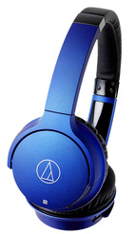

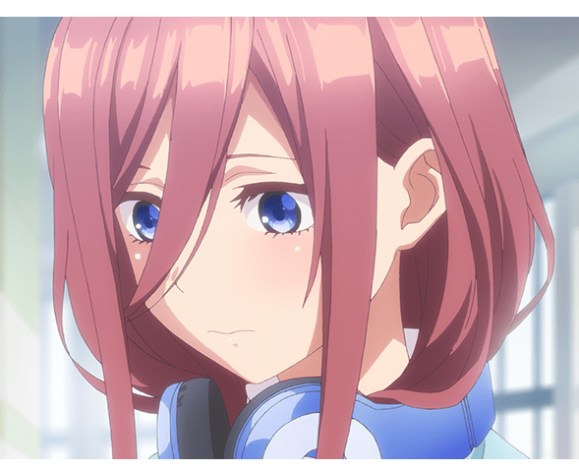
What is good embedding?
An embedding should represent the object.
是一對
不是一對

Slide 4



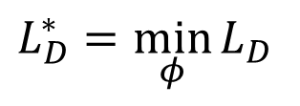
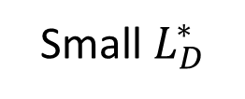
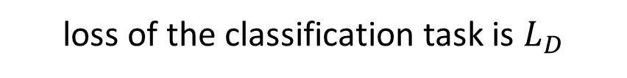
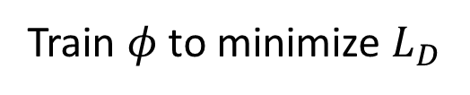
Beyond Reconstruction
Train $φ$ to minimize $L_{D}$
$$L_{D}^{∗}=\min_{φ}{L_{D}}$$
How to evaluate an encoder?
Small $L_{D}^{∗}$
The embeddings are representative.
loss of the classification task is $L_{D}$
image
Discriminator
y/n
$$φ$$
binary classifier
NN
Encoder
Say “Yes”
NN
Encoder
Say “No”
Notes:
In real implementation, do we slit into train and test

Slide 5
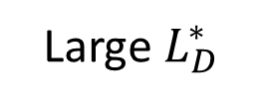
Beyond Reconstruction
Train $φ$ to minimize $L_{D}$
$$L_{D}^{∗}=\min_{φ}{L_{D}}$$
How to evaluate an encoder?
Small $L_{D}^{∗}$
The embeddings are representative.
loss of the classification task is $L_{D}$
Large $L_{D}^{∗}$
Not representative
image
Discriminator
y/n
$$φ$$
binary classifier
NN
Encoder
Say “Yes”
NN
Encoder
Say “No”

Slide 6
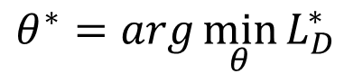

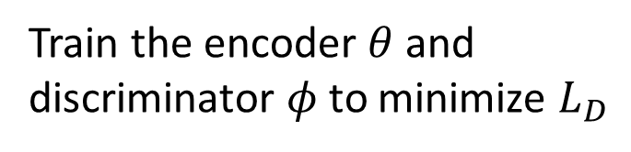

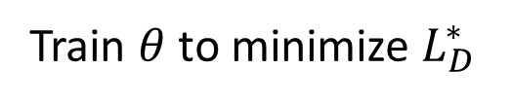
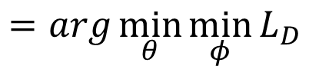
Beyond Reconstruction
Train $φ$ to minimize $L_{D}$
$$L_{D}^{∗}=\min_{φ}{L_{D}}$$
How to evaluate an encoder?
Small $L_{D}^{∗}$
The embeddings are representative.
loss of the classification task is $L_{D}$
Large $L_{D}^{∗}$
Not representative
image
Discriminator
y/n
$$φ$$
Train $θ$ to minimize $L_{D}^{∗}$
binary classifier
$$θ^{∗}=arg\min_{θ}{L_{D}^{∗}}$$
NN
Encoder
$$=arg\min_{θ}{\min_{φ}{L_{D}}}$$
Train the encoder $θ$ and discriminator $φ$ to minimize $L_{D}$
$$θ$$
NN
Encoder
Deep InfoMax (DIM)
(c.f. training encoder and decoder to minimize reconstruction error)
$$θ$$
Notes:
Does it train iteratively????????

Slide 7
Typical auto-encoder is a special case
As close as possible
NN
Encoder
NN
Decoder
vector
-
score
(reconstruction error)
NN
Decoder
vector
Discriminator

Slide 8
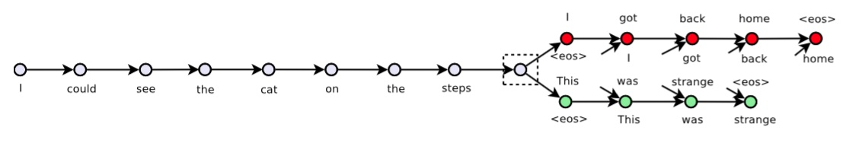
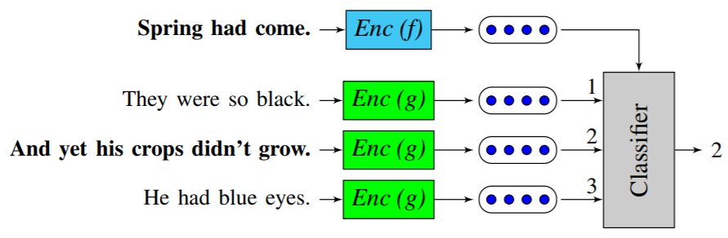
Sequential Data
A document is a sequence of sentences.
previous
Skip thought
current
https://papers.nips.cc/paper/5950-skip-thought-vectors.pdf
next
Quick thought
current
random
next
random
https://arxiv.org/pdf/1803.02893.pdf
Notes:
In our experiments, c is simply defined to be an inner product c(u, v) = u T v

Slide 9
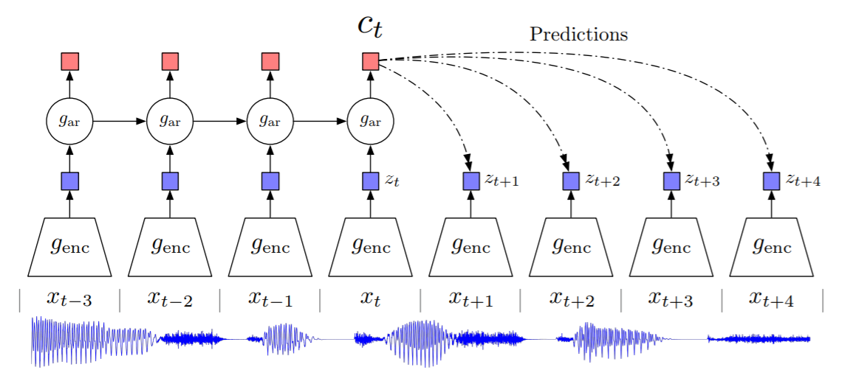
Sequential Data
Contrastive Predictive Coding (CPC)
https://arxiv.org/pdf/1807.03748.pdf

Slide 10
Auto-encoder
As close as possible
NN
Encoder
NN
Decoder
vector
Embedding, Latent Representation, Latent Code
More than minimizing reconstruction error
More interpretable embedding

Slide 11
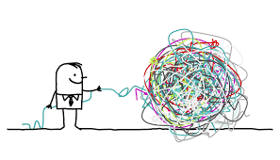
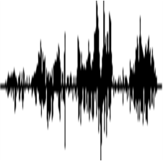
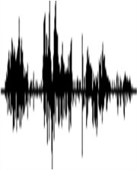


Feature Disentangle
Source: https://www.dreamstime.com/illustration/disentangle.html
An object contains multiple aspect information
Encoder
Decoder
input audio
reconstructed
Include phonetic information, speaker information, etc.
Encoder
Decoder
input sentence
reconstructed
Include syntactic information, semantic information, etc.

Slide 12
Feature Disentangle
phonetic information
Encoder
Decoder
input audio
reconstructed
speaker information
phonetic information
Encoder 1
Decoder
Encoder 2
reconstructed
speaker information

Slide 13


Feature Disentangle - Voice Conversion
How are you?
Encoder
Decoder
How are you?
How are you?
Hello
Encoder
Decoder
Hello
Hello

Slide 14
Feature Disentangle - Voice Conversion
How are you?
Encoder
How are you?
How are you?
Decoder
Hello
Encoder
Hello
How are you?

Slide 15
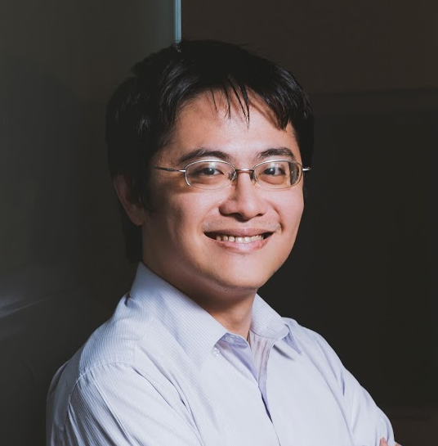

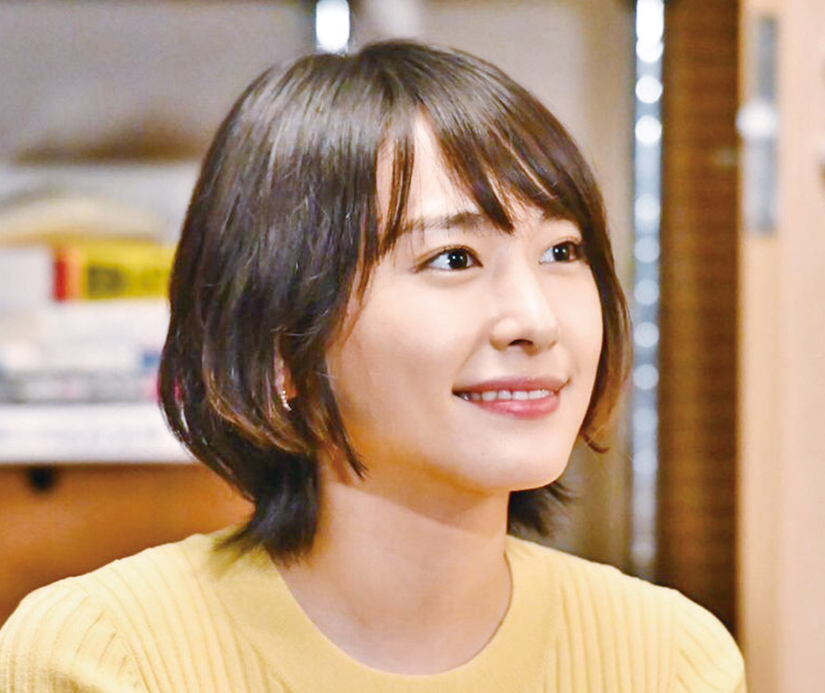

Feature Disentangle - Voice Conversion
The same sentence has different impact when it is said by different people.
Do you want to study a PhD?
Go away!
Student
Do you want to study a PhD?
新垣結衣
(Aragaki Yui)
Student

Slide 16
Feature Disentangle - Adversarial Training
Learn to fool the speaker classifier
Speaker
Classifier
or
(Discriminator)
How are you?
Encoder
Decoder
How are you?
How are you?
Speaker classifier and encoder are learned iteratively

Slide 17
Feature Disentangle - Designed Network Architecture
How are you?
Encoder
1
IN
How are you?
Decoder
How are you?
How are you?
Encoder
2
IN
= instance normalization
(remove global information)

Slide 18
Feature Disentangle - Designed Network Architecture
How are you?
Encoder
1
IN
Decoder
AdaIN
How are you?
How are you?
Encoder
2
IN
= instance normalization
(remove global information)
AdaIN
= adaptive instance normalization
(only influence global information)

Slide 19

Feature Disentangle - Adversarial Training
Target Speaker
Source Speaker
Source to Target
(Never seen during training!)
Me
Me
Me
Me
Thanks Ju-chieh Chou for providing the results.
https://jjery2243542.github.io/voice_conversion_demo/
Notes:
https://b04901014.github.io/ISGAN/
感謝周儒杰同學提供實驗結果

Slide 20
Discrete Representation
non differentiable
Easier to interpret or clustering
https://arxiv.org/pdf/1611.01144.pdf
One-hot
NN
Encoder
0.9
0.1
0.3
0.7
1
0
0
0
NN
Decoder
Binary
NN
Encoder
0.9
0.1
0.3
0.7
1
0
0
1
NN
Decoder

Slide 21
Discrete Representation
https://arxiv.org/abs/1711.00937
Vector Quantized Variational Auto-encoder (VQVAE)
NN
Encoder
NN
Decoder
vector
vector 3
Codebook
(a set of vectors)
Compute similarity
vector 1
vector 2
vector 5
vector 3
vector 4
The most similar one is the input of decoder.
Learn from data
For speech, the codebook represents phonetic information
https://arxiv.org/pdf/1901.08810.pdf

Slide 22



Sequence as Embedding
https://arxiv.org/abs/1810.02851
Only need a lot of documents to train the model
This is a seq2seq2seq auto-encoder.
Using a sequence of words as latent representation.
not readable …
word
sequence
document
document
G
R
Summary?
Seq2seq
Seq2seq

Slide 23
Sequence as Embedding
Human written summaries
Real or not
Let Discriminator considers my output as real
D
Discriminator
word
sequence
document
document
Readable
G
R
Summary?
Seq2seq
Seq2seq

Slide 24
Sequence as Embedding
感謝 王耀賢 同學提供實驗結果
Document:澳大利亞今天與13個國家簽署了反興奮劑雙邊協議,旨在加強體育競賽之外的藥品檢查並共享研究成果 ……
Summary:
Human:澳大利亞與13國簽署反興奮劑協議
Unsupervised:澳大利亞加強體育競賽之外的藥品檢查
Document:中華民國奧林匹克委員會今天接到一九九二年冬季奧運會邀請函,由於主席張豐緒目前正在中南美洲進行友好訪問,因此尚未決定是否派隊赴賽 ……
Summary:
Human:一九九二年冬季奧運會函邀我參加
Unsupervised:奧委會接獲冬季奧運會邀請函

Slide 25
Sequence as Embedding
感謝 王耀賢 同學提供實驗結果
Document:據此間媒體27日報道,印度尼西亞蘇門答臘島的兩個省近日來連降暴雨,洪水泛濫導致塌方,到26日為止至少已有60人喪生,100多人失蹤 ……
Summary:
Human:印尼水災造成60人死亡
Unsupervised:印尼門洪水泛濫導致塌雨
Document:安徽省合肥市最近為領導幹部下基層做了新規定:一律輕車簡從,不準搞迎來送往、不準搞層層陪同 ……
Summary:
Human:合肥規定領導幹部下基層活動從簡
Unsupervised:合肥領導幹部下基層做搞迎來送往規定:一律簡

Slide 26
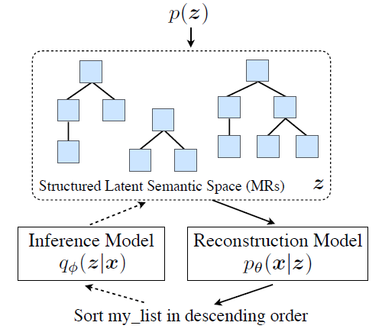
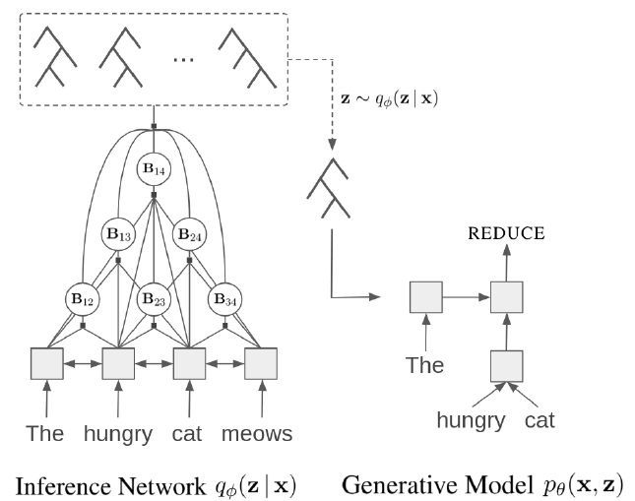
Tree as Embedding
https://arxiv.org/abs/1806.07832
https://arxiv.org/abs/1904.03746
Notes:
https://vimeo.com/285800885

Slide 27
Concluding Remarks
As close as possible
NN
Encoder
NN
Decoder
code
More than minimizing reconstruction error
Using Discriminator
Sequential Data
More interpretable embedding
Feature Disentangle
Discrete and Structured

